Slide 1
SAP HANA on Azure

Slide 2
Abstract and learning objectives
Abstract
In this workshop, you will look at what is involved in deploying SAP HANA on Azure with the goals of designing for high availability and disaster recovery.
At the end of this workshop, you will be able to design and deploy SAP HANA on Azure.
Learning objectives:
Identify requirements for deployment SAP HANA workloads on Azure VMs
Design high availability for SAP HANA workloads on Azure VMs
Design disaster recovery for SAP HANA workloads on Azure VMs

Slide 3
Step 1: Review the customer case study
Outcome
Analyze your customer needs.
Timeframe
15 minutes

Slide 4
Customer situation
Contoso Group
Contoso Group is a global pharmaceutical company with its headquarters based in Boston, US.
Contoso has been using SAP ERP and BW on HANA for its Finance/Logistics/Analytics systems on the HP-UX/Oracle platform.
Contoso Leadership and Planning Groups wants to significantly reduce server and storage hardware in their own datacenters to minimize IT related costs. The leadership asked Contoso IT to look into the possibility of migrating its SAP HANA environment to cloud. Contoso is also considering transitioning to SAP HANA 2.0 with a longer term objective of deploying S/4 HANA and BW/4 HANA.
Contoso has already a number of their non-SAP systems migrated to Azure. Contoso IT decided to leverage its knowledge of the Microsoft cloud platform and existing ExpressRoute connectivity and host its SAP landscape in Azure. The intention is to migrate the BW system first (go live in March CY20), and migrate ECC in Q4 of CY20. The multi-stage approach is supposed to minimize potential migration risks.
Considering that Contoso management team often uses BW to support their management decisions, the systems should be highly available, and their performance must be predictable and consistent. In addition, the management team wants to leverage disaster recovery capabilities offered by Azure in order to ensure resiliency of the migrated environment in case the primary region hosting the new deployment becomes unavailable.

Slide 5
Customer situation
Contoso Group
As Andrew Cross, CIO of Contoso Group emphasized this point by stating "Our operational dependencies on SAP applications force us to seek reasonably priced availability and disaster recovery capabilities for our production SAP HANA deployments.“
Contoso also wants to dramatically simplify the process of provisioning Azure resources, as well as installation and configuration of SAP HANA software components. Contoso IT has been relying on Ansible to manage its on-premises environment and, with the cloud migration plans, it started evaluating the use of Terraform to automate on-premises and cloud-based deployments.
Before migrating the production environment, Contoso wants to test its new deployment approach by provisioning training, development, test, and UAT environments in Azure.

Slide 6
Customer situation
“Our operational dependencies on SAP applications force us to seek reasonably priced, cloud-based availability and disaster recovery capabilities for our production SAP HANA deployments.”
Andrew Cross, CIO, Contoso Group

Slide 7
Customer needs
Highly responsive systems with low network latency
In-memory database performance
High availability & disaster recovery
Enterprise data protection & security
Safe migration with downtime minimized
Access from HANA-based applications
Automated provisioning
Minimized cost

Slide 8
Customer needs (1/4)
Scope : SAP BW migration to HANA in Azure VMs
Go-live date : March 2020
Current BW (ABAP Unicode) on-premises with HP-UX/Oracle and application layer on Linux
ERP is kept on-premises (with HP-UX/Oracle) until December 2020
Data is transferred from ERP (on-premises) to BW (in Cloud) every hour
Customer requests flexible VM solution within Cloud to accommodate the BW workloads.
Use 1-year Reserved VM Instance option for Production VMs
(Option) Need to start to prepare for ERP migration to Cloud

Slide 9
Customer needs (2/4)
Sizing
Production (3-tier) with latest OS/DB fully certified and supported by SAP
HANA sizing memory requirement 1.2 TB, estimate 1.9 TB in 3 years
Throughput DB files at least 400MB/s [/hana/data]
Throughput DB Log files at least 250MB/s [/hana/log]
BW application servers: 15K SAPS
Certification is NOT required for non-Prod
QA (2-tier) HANA database server: 800 GB
Dev, Test (both 2-tier) HANA database server(s): 256 GB
Uptime – Prod: 24x7, 744 hrs/m, QA - 50 hrs/m, DEV/Test - 200 hrs/m

Slide 10
Customer needs (3/4)
Availability and Backup
Both HA and Non-HA options need to be proposed
With HA option, in case of server/storage issues, auto failover to complete within a few minutes, in case of a disaster recovery within 1 day
Long term backup – use backup storage in Cloud
Data loss not allowed
HANA DB log backup taken every 30 minutes
DB log backup to be kept for 1 day (DB restore to be fast)
HANA DB full backup every night
Daily HANA DB full backup to be retained for 1 month
Monthly HANA DB full backup for 1 year, annual for 3 years

Slide 11
Customer needs (4/4)
End user access
User locations – 300 from US, 50 LATAM, 50 Europe, 30 Asia - all intranet
Currently ExpressRoute is set up to Azure East US 2
User response time needs to be minimized

Slide 12
Customer questions and objections
ECC remains on-premises until Dec CY20 – how can we maintain integrations between ECC and BW?
How much does Azure cost? Give us two options (HA only and HA with DR).
Do I have to pay for virtual machines when they are stopped?
Can I automate the shutdown of virtual machines at periodic times of day?

Slide 13
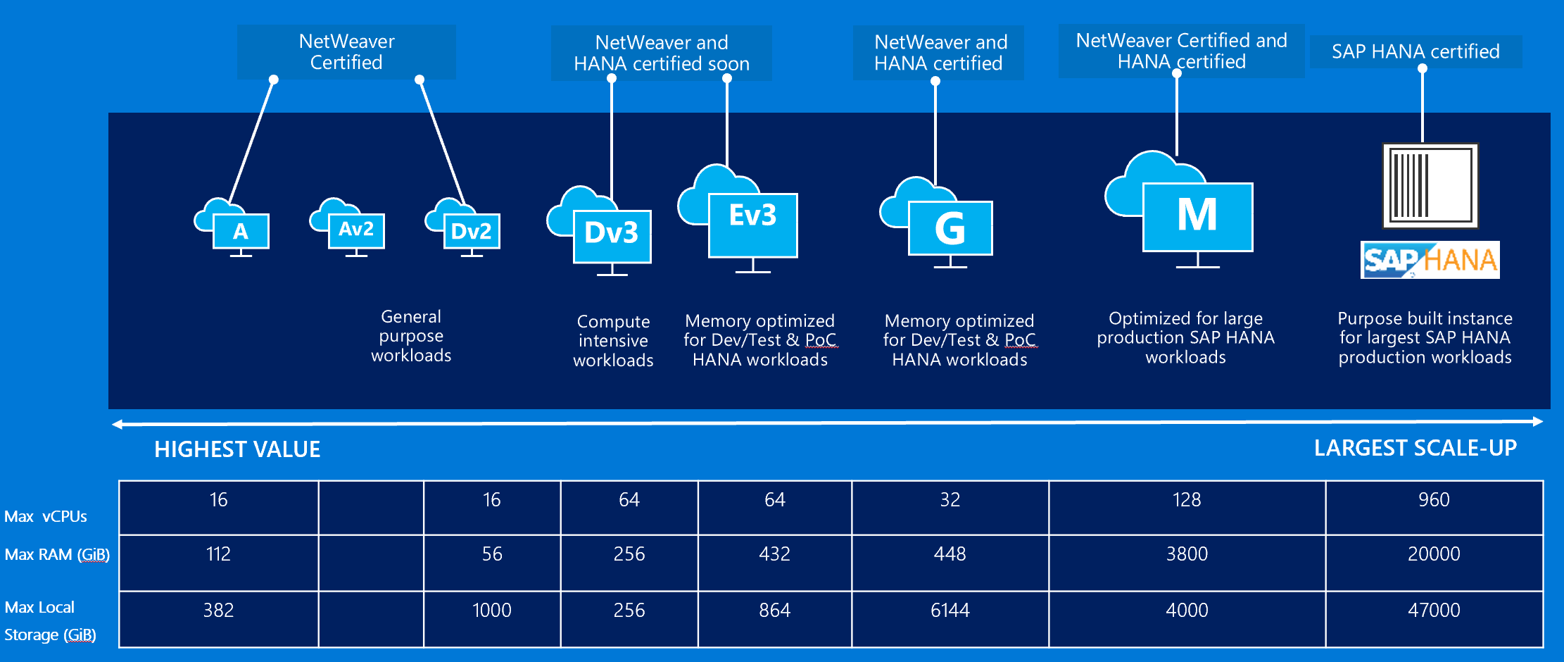
SAP on Azure — huge variety on instances

Slide 14
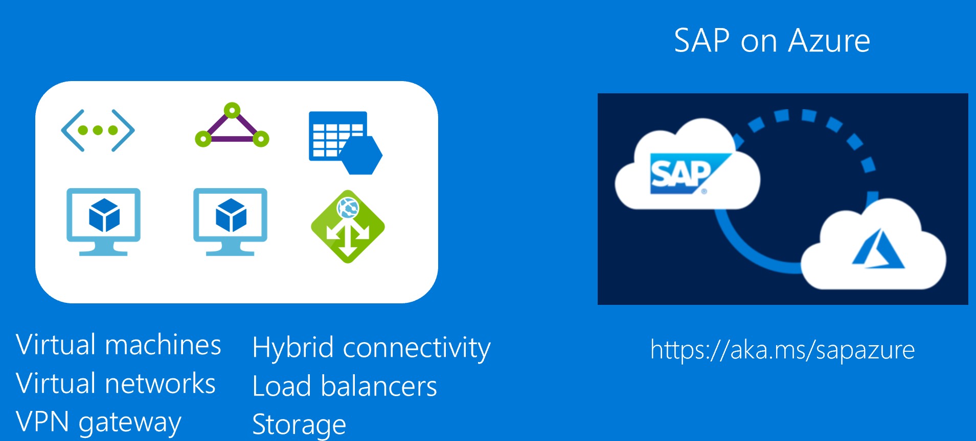
Common scenarios
Notes:
Common solutions for the case study include virtual machines, virtual networks, VPN gateway, hybrid connectivity, load balancers, and storage, as well as SAP on Azure, with more information available via https://aka.ms/sapazure

Slide 15
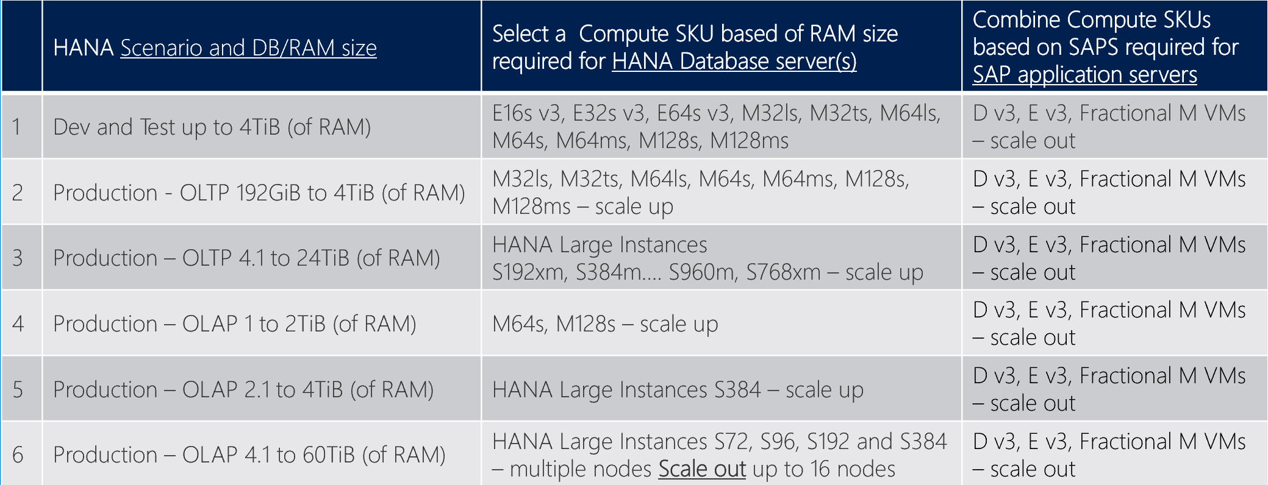
Determine Azure SKUs for HANA based on HANA DB Size and SAPS
(*) OLAP : BW on HANA, BW/4HANA, Enterprise DWH, Sidecar | OLTP : S/4HANA, Business Suite on HANA, NetWeaver

Slide 16
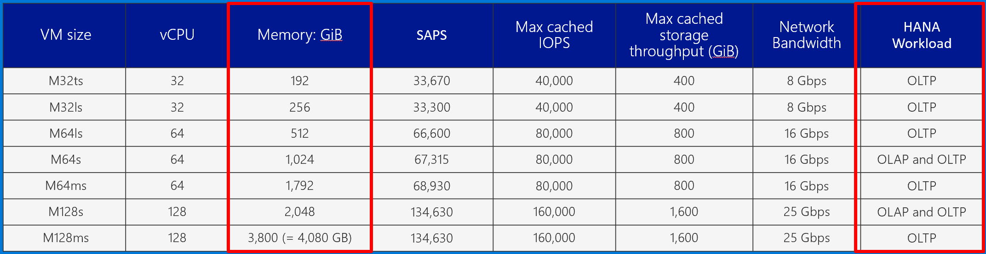
M-Series Virtual Machines Massive memory, CPU, storage, and scale
Hyper-Threaded support
Premium Storage and Write Accelerator support
Based on Intel® Xeon® Processor E7-8890 v3
High Performance DDR4 memory
SAP Certified for both HANA and AnyDB
(*) OLAP : BW on HANA, BW/4HANA, Enterprise DWH, Sidecar
(*) OLTP : S/4HANA, Business Suite on HANA, NetWeaver
Notes:
Key talking points:
The M-series is the largest instance size with up to 128 virtual cpu’s (VCPUs). These instances support premium storage for low latency workloads and are designed for the largest enterprise workloads. These have huge RAM sizes from 1.75TB to 4.0TB of RAM!

Slide 17
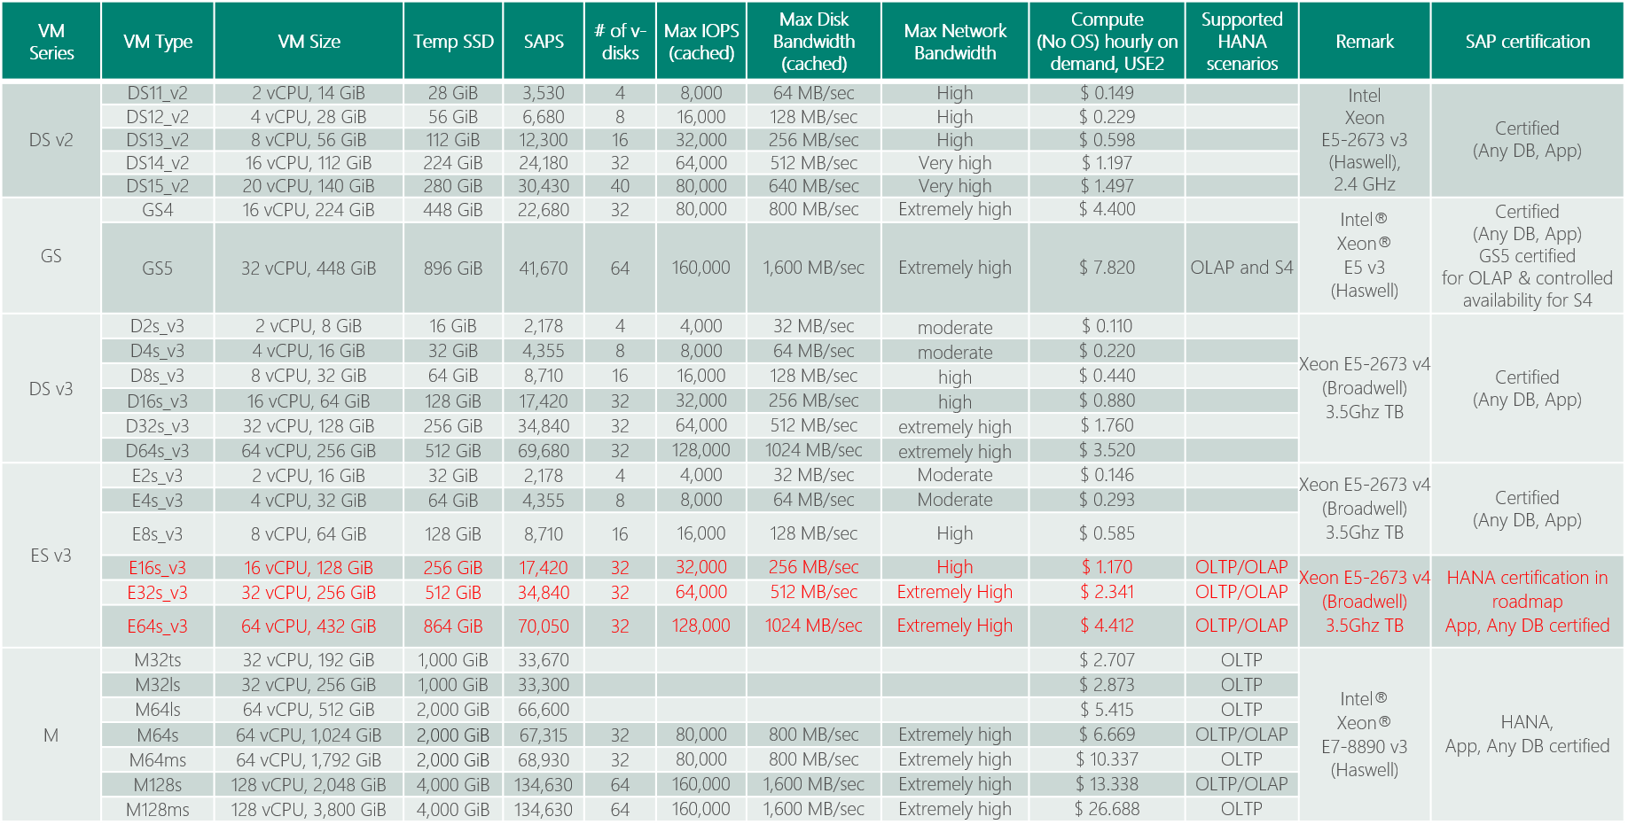
(SAPS) Azure VM Options for SAP Applications
SAP Note 1928533 and https://docs.microsoft.com/en-us/azure/virtual-machines/windows/sizes-memory
Red: certification in roadmap

Slide 18
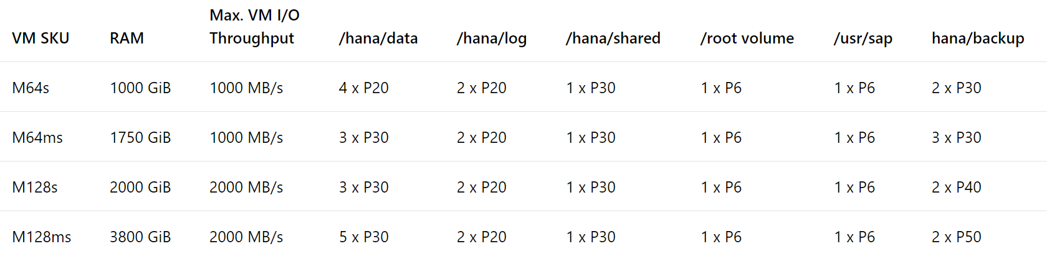
Premium Storage Allocation to run SAP HANA on Azure M Series VM
Enable Write Accelerator
All the disks building those volumes should have caching of those disks set to 'None'.
https://docs.microsoft.com/en-us/azure/virtual-machines/workloads/sap/hana-vm-operations
As stripe sizes for the RAID 0 the recommendation is to use:
64K or 128K for /hana/data
32K for /hana/log (as Only smaller I/O sizes (<=32KiB) are taking the accelerated path of Write Accelerator)
https://docs.microsoft.com/en-us/azure/virtual-machines/linux/how-to-enable-write-accelerator

Slide 19

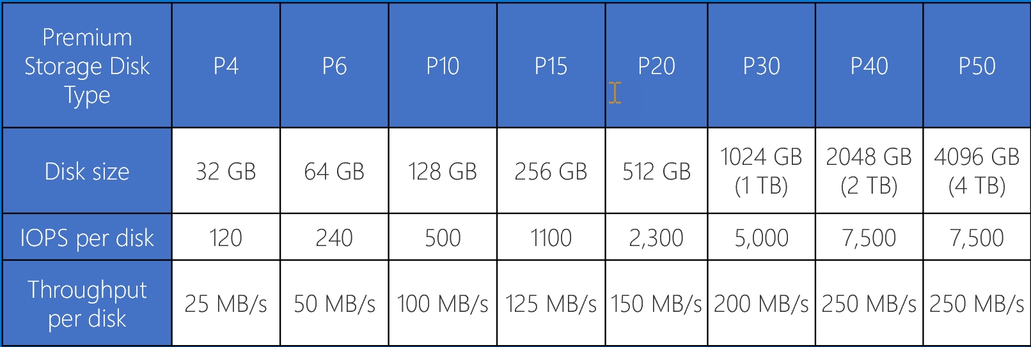
Premium Storage KPIs (Cost differ by region)
Consistent low latency SSD with predictable throughput
For high-performance IO-intensive DB workloads
Single digit ms latencies
Supports up to 4 TB blob/disk size
Stripe up to 64 disks for a total of 256 TB
Disk performance is dependent on the disk size, with up to 7,500 IOPS per disk
Pay for what you provision
Check Azure VMs for maximum IOPS
* Stripe Premium Storage Disks to aggregate
IOPS, Throughput and Storage Capacity

Slide 20
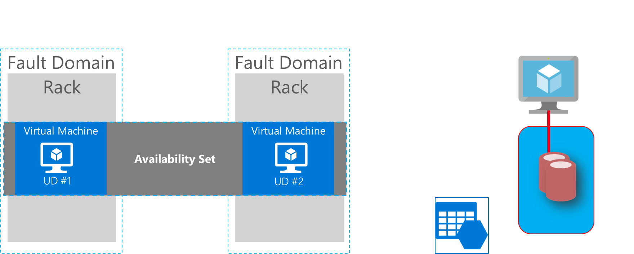
Common Scenarios

Slide 21
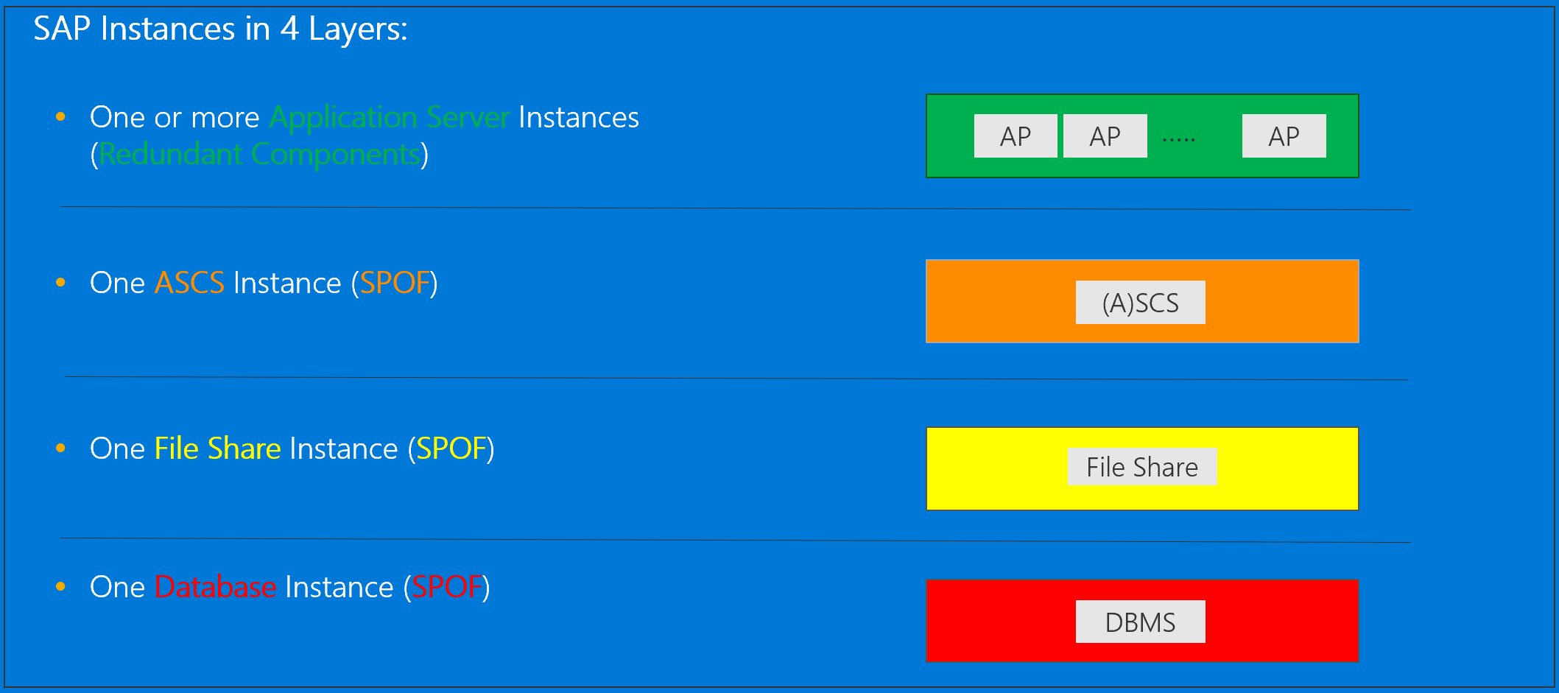
SAP HA Architecture SAP NetWeaver ABAP / Java 7.00 (and higher) – Windows & Linux

Slide 22
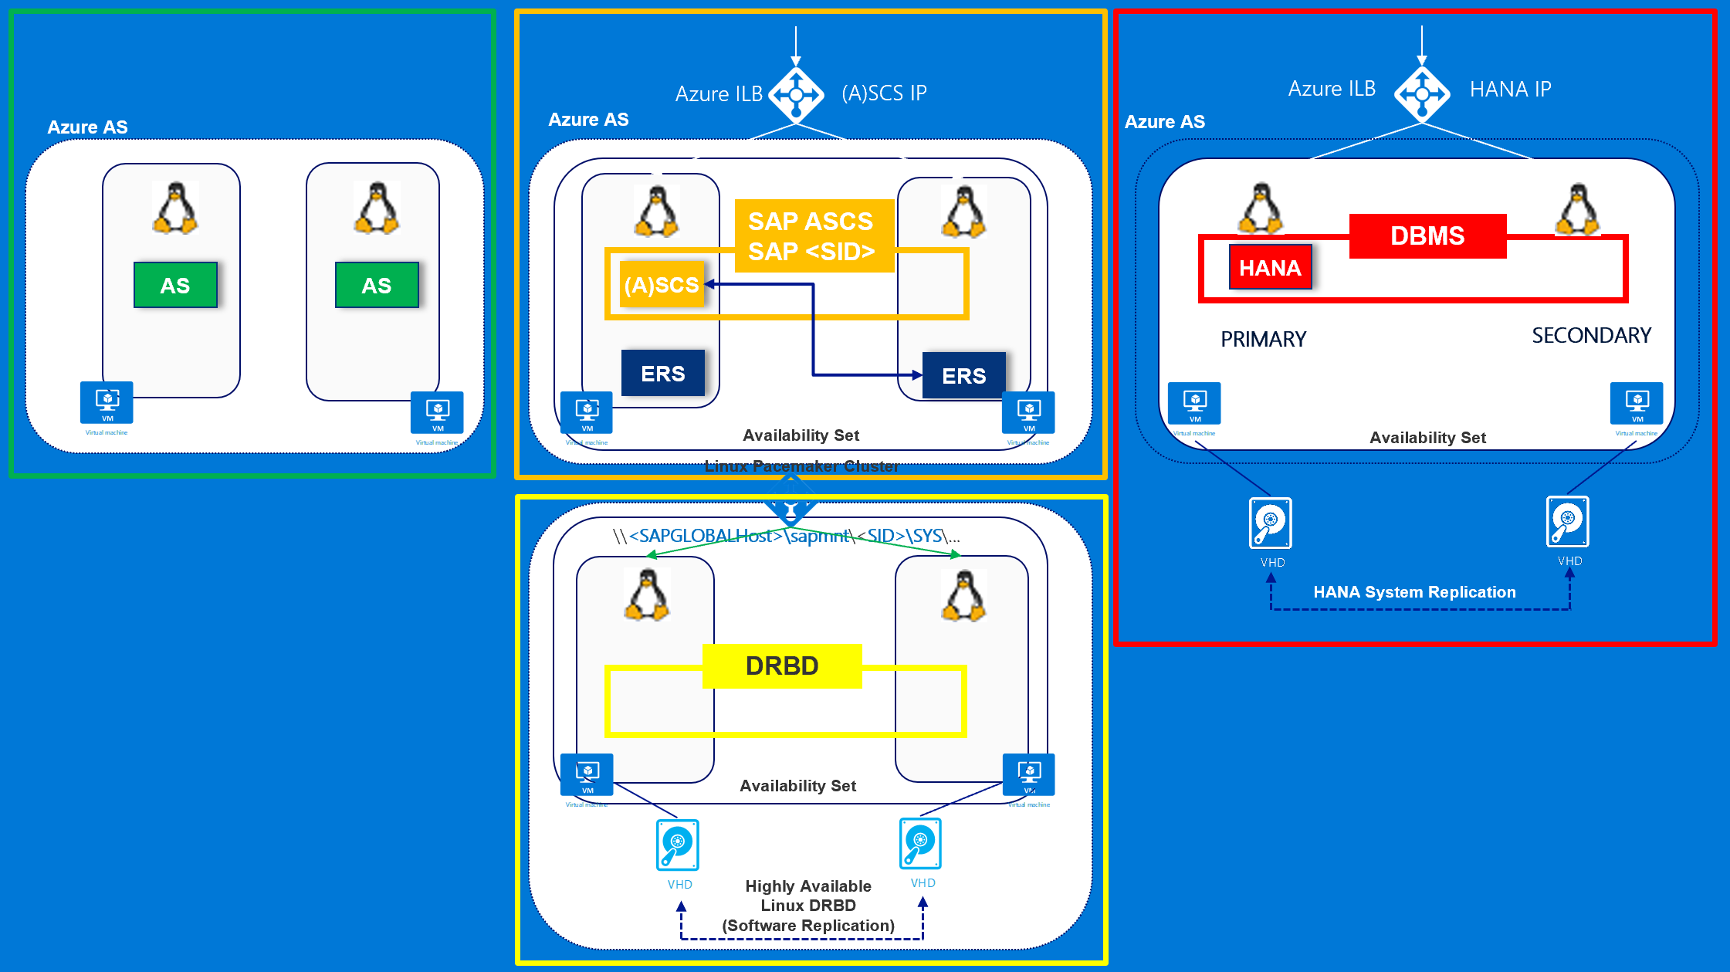

Slide 23
Step 2: Design the solution
Outcome
Design a solution and prepare to present the solution to the target customer audience in a 15-minute chalk-talk format.
Timeframe
60 minutes
Business needs (10 minutes) | Respond to questions outlined in your guide and list the answers on a flipchart.
Design (35 minutes) | Design a solution for as many of the stated requirements as time allows. Show the solution on a flipchart.
Prepare (15 minutes) | Identify any customer needs that are not addressed with the proposed solution. Identify the benefits of your solution. Determine how you will respond to the customer’s objections. Prepare for a 15-minute presentation to the customer.

Slide 24
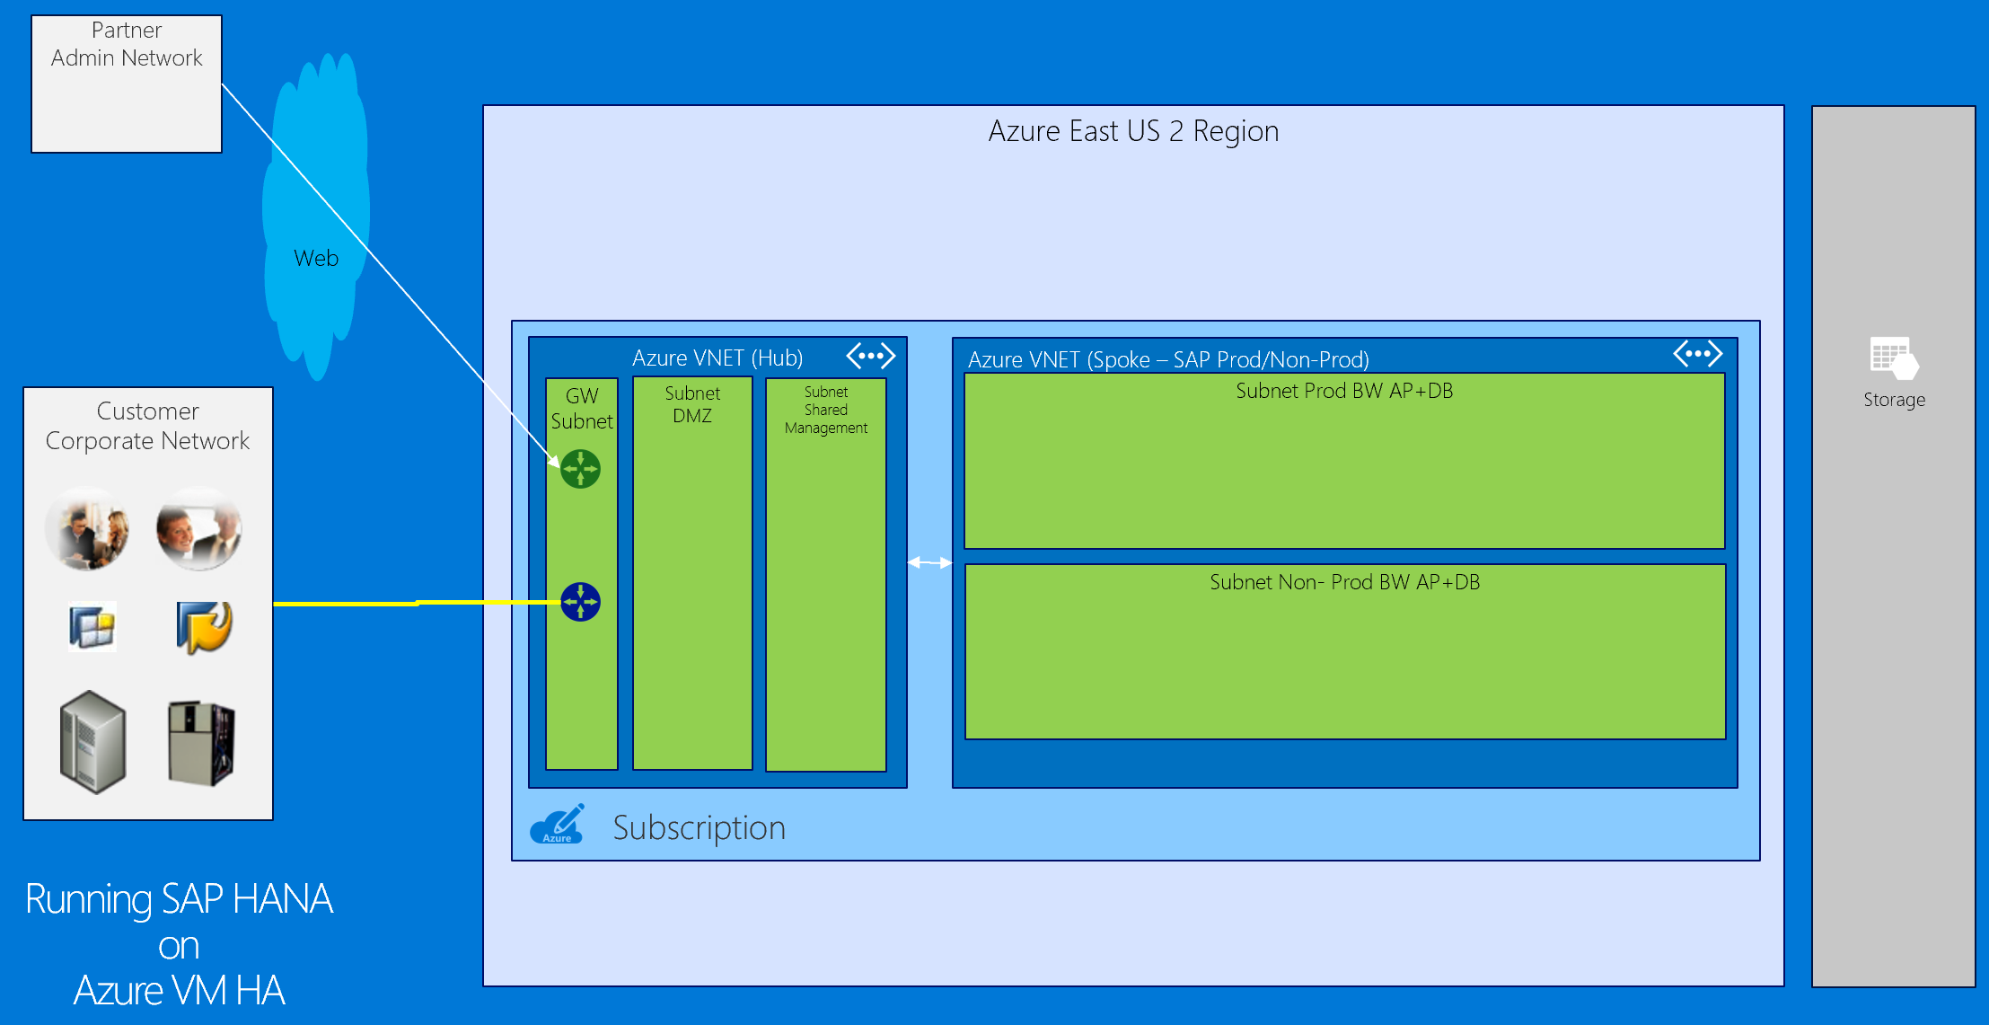

Slide 25
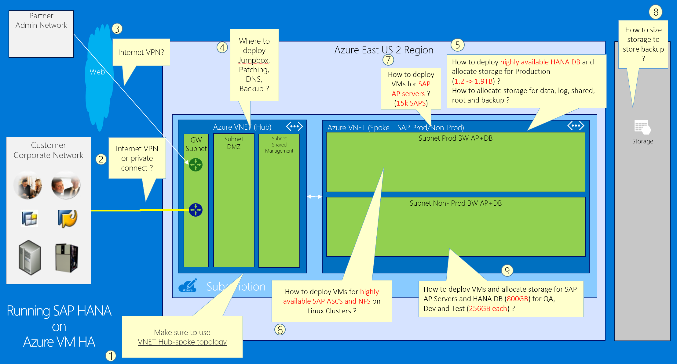

Slide 26
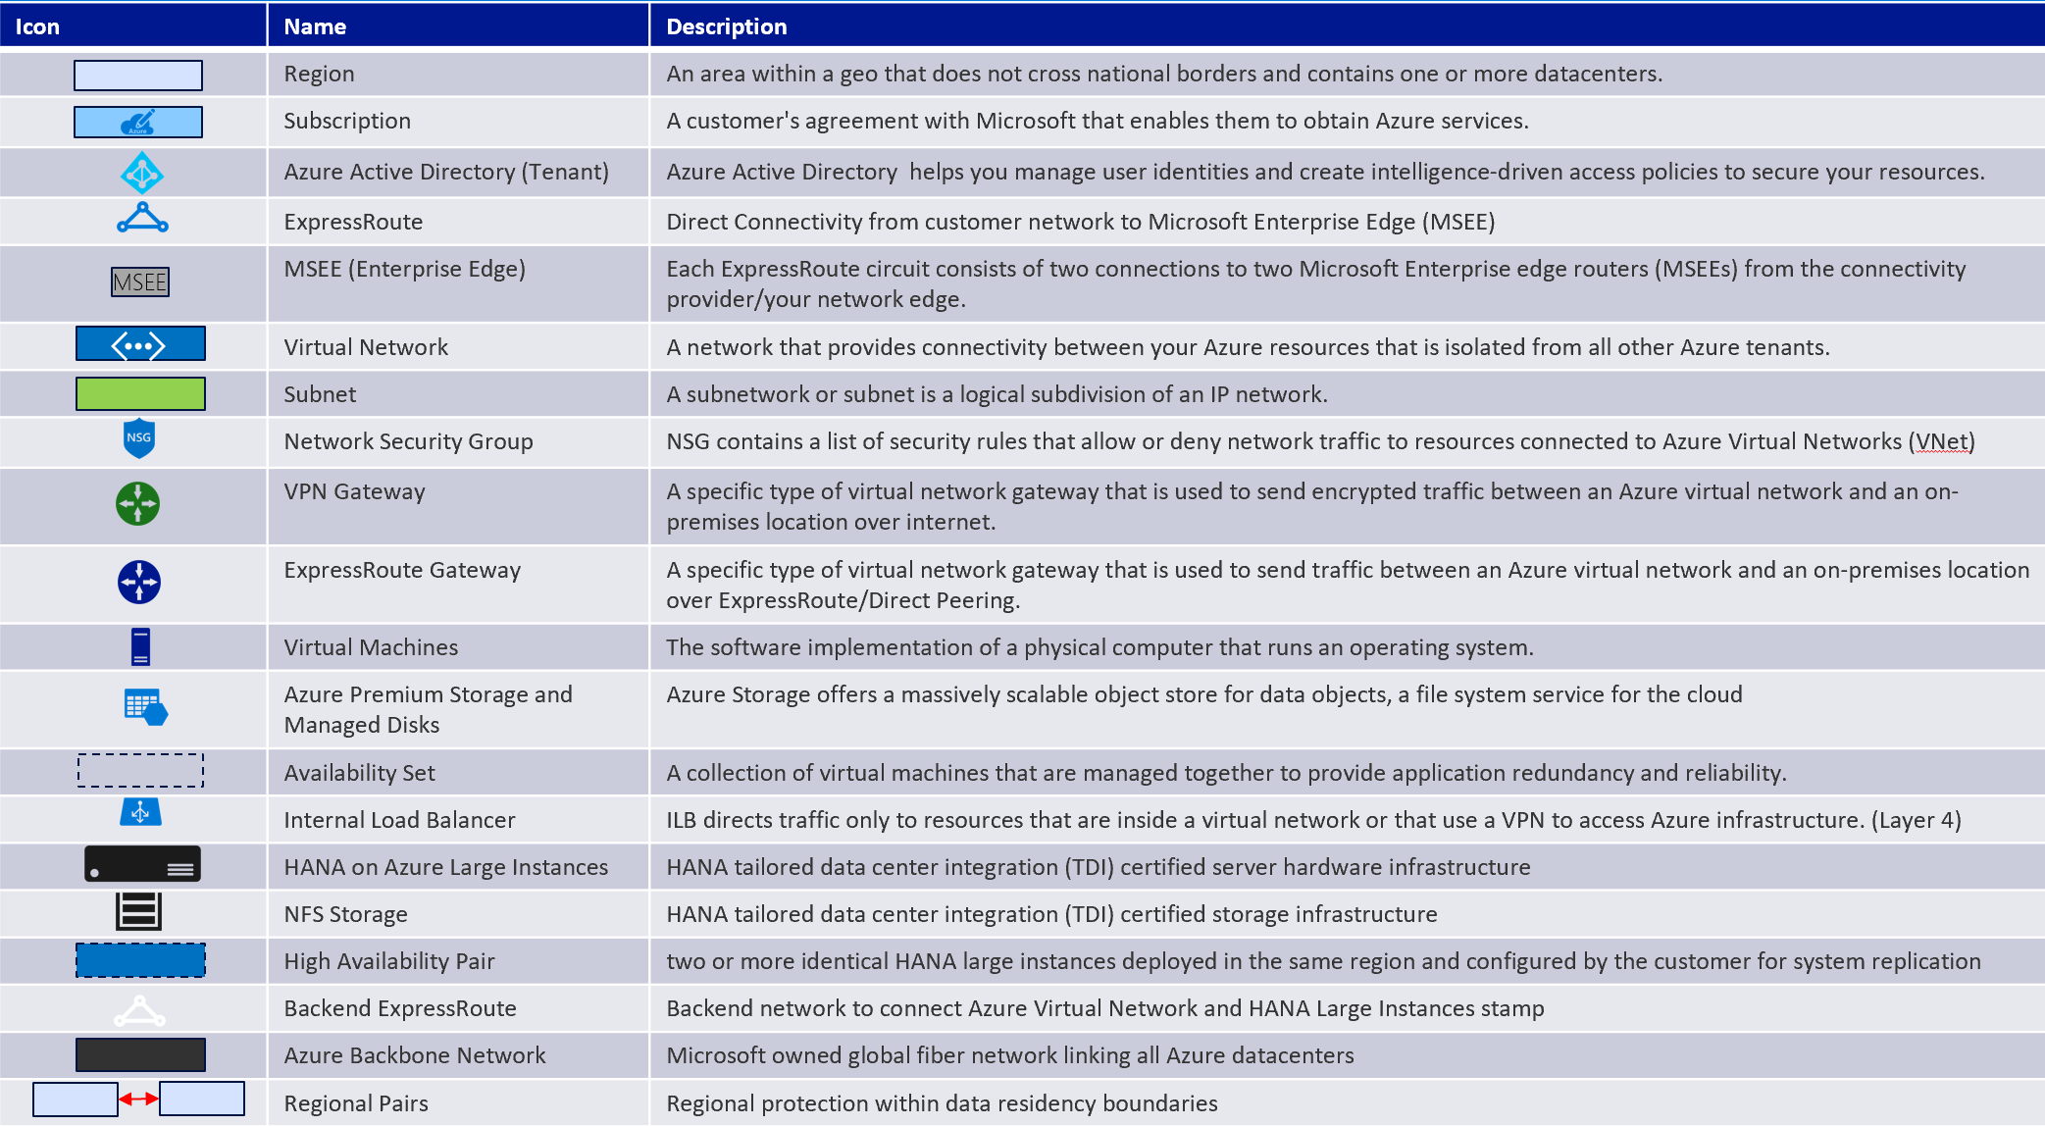
Baseline knowledge for SAP as a service on Azure

Slide 27
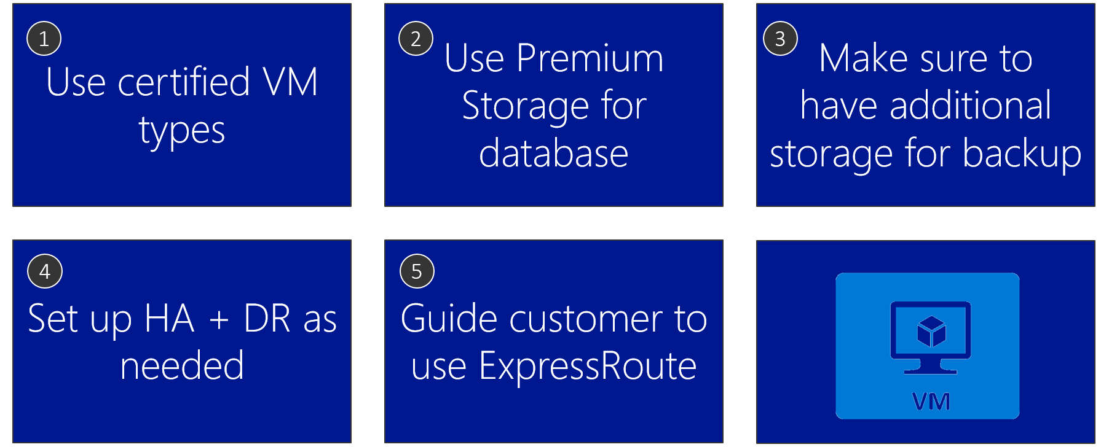
Azure VM design tips
Notes:
The proposed design:
Uses SAP certified VM sizes (required)
Uses Premium Storage for databases (required)
Accounts additional storage for backup (as per customer’s specifications)
HA/DR (as per customer’s specifications)
Uses ExpressRoute (as per customer’s specifications)

Slide 28
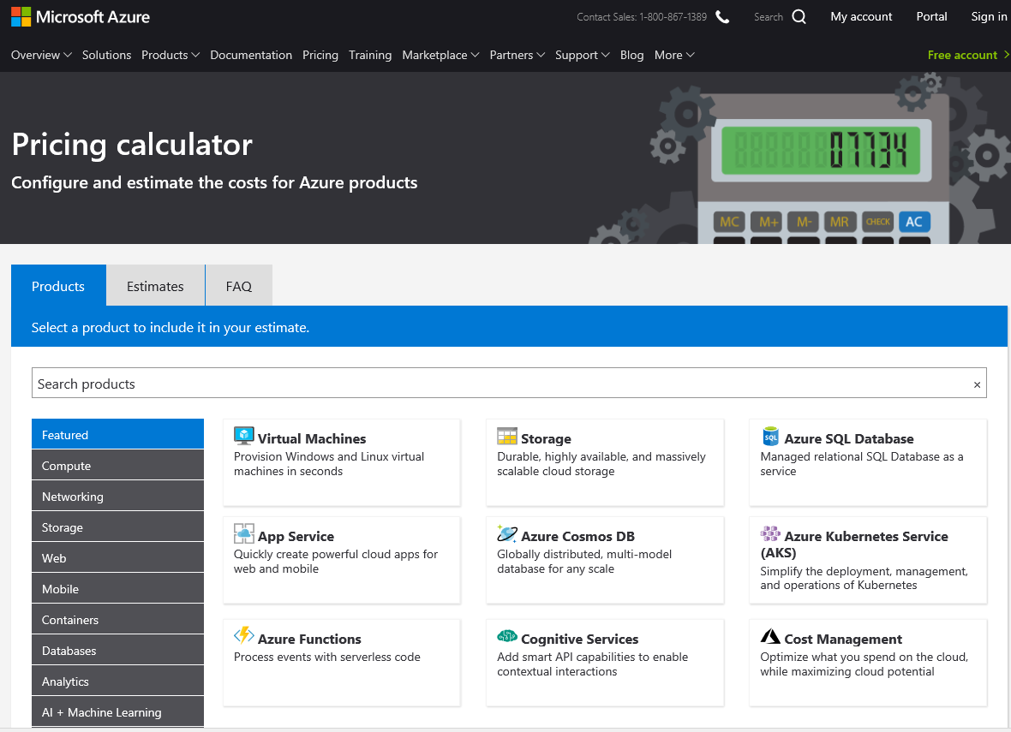
Online Azure pricing calculator
https://azure.microsoft.com/en-us/pricing/calculator/
Notes:
To estimate the cost of your solution, use Azure Pricing Calculator.

Slide 29
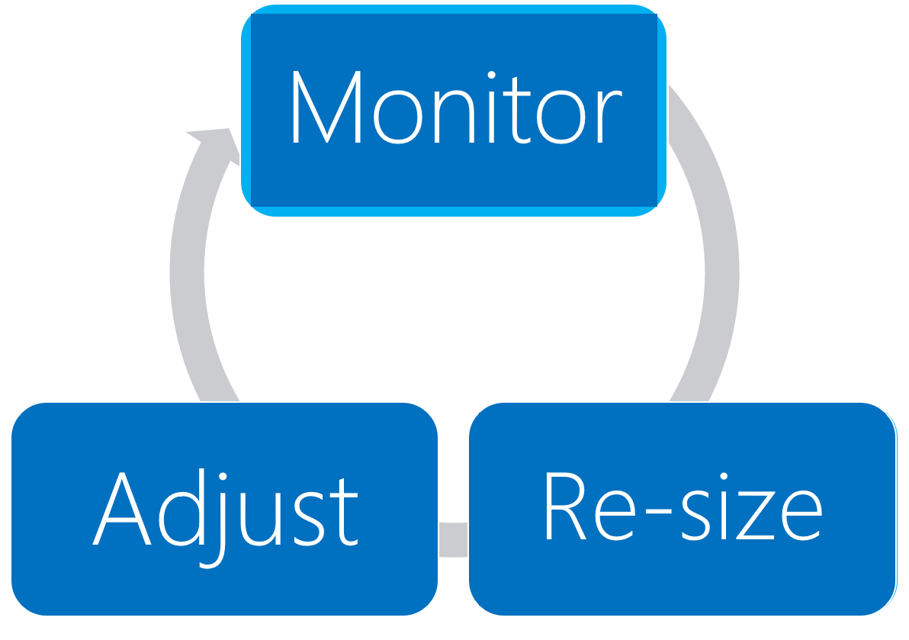
Process to optimize SAP landscape
Notes:
The solution sizing is a continuous process that involve monitoring, re-sizing, and adjusting. Fortunately, resizing Azure VMs is a straightforward process.

Slide 30
Pricing
Customer is very cost sensitive
No need to include OS/DB license costs (Customer will do BYOL separately)
BYOL of 3rd party backup solution (e.g. Commvault)
ExpressRoute : Start with 500Mbps
ExpressRoute Additional outbound data transfer : 5TB/month
Make sure to include MSFT support (= Professional Direct)

Slide 31
Step 3: Present the solution
Outcome
Present a solution to the target customer in a 15-minute chalk-talk format.
Timeframe
30 minutes (15 minutes for each team to present and receive feedback)
Directions
Pair with another table.
One table is the Microsoft team and the other table is the customer.
The Microsoft team presents their proposed solution to the customer.
The customer asks one of the objections from the list of objections in the case study.
The Microsoft team responds to the objection.
The customer team gives feedback to the Microsoft team.

Slide 32
Wrap-up
Outcome
Identify the preferred solution for the case study.
Identify solutions designed by other teams.
Timeframe
15 minutes

Slide 33
Preferred target audience
Business Development Manager (BDM) or Application Sponsor (CFO)
Funds projects & apps
Most interested in public cloud
Business Unit IT / Developers (Director of SAP Business Analysts, Director of SAP Operations)
Reports to BDM and is responsible for coding and testing apps
Big influencer of public cloud strategy
Central IT (VP of IT Operations)
Reports into CIO and responsible for operating datacenter
Concerned about shadow IT created issues: security/compliance, server sprawl, and lack of control

Slide 34
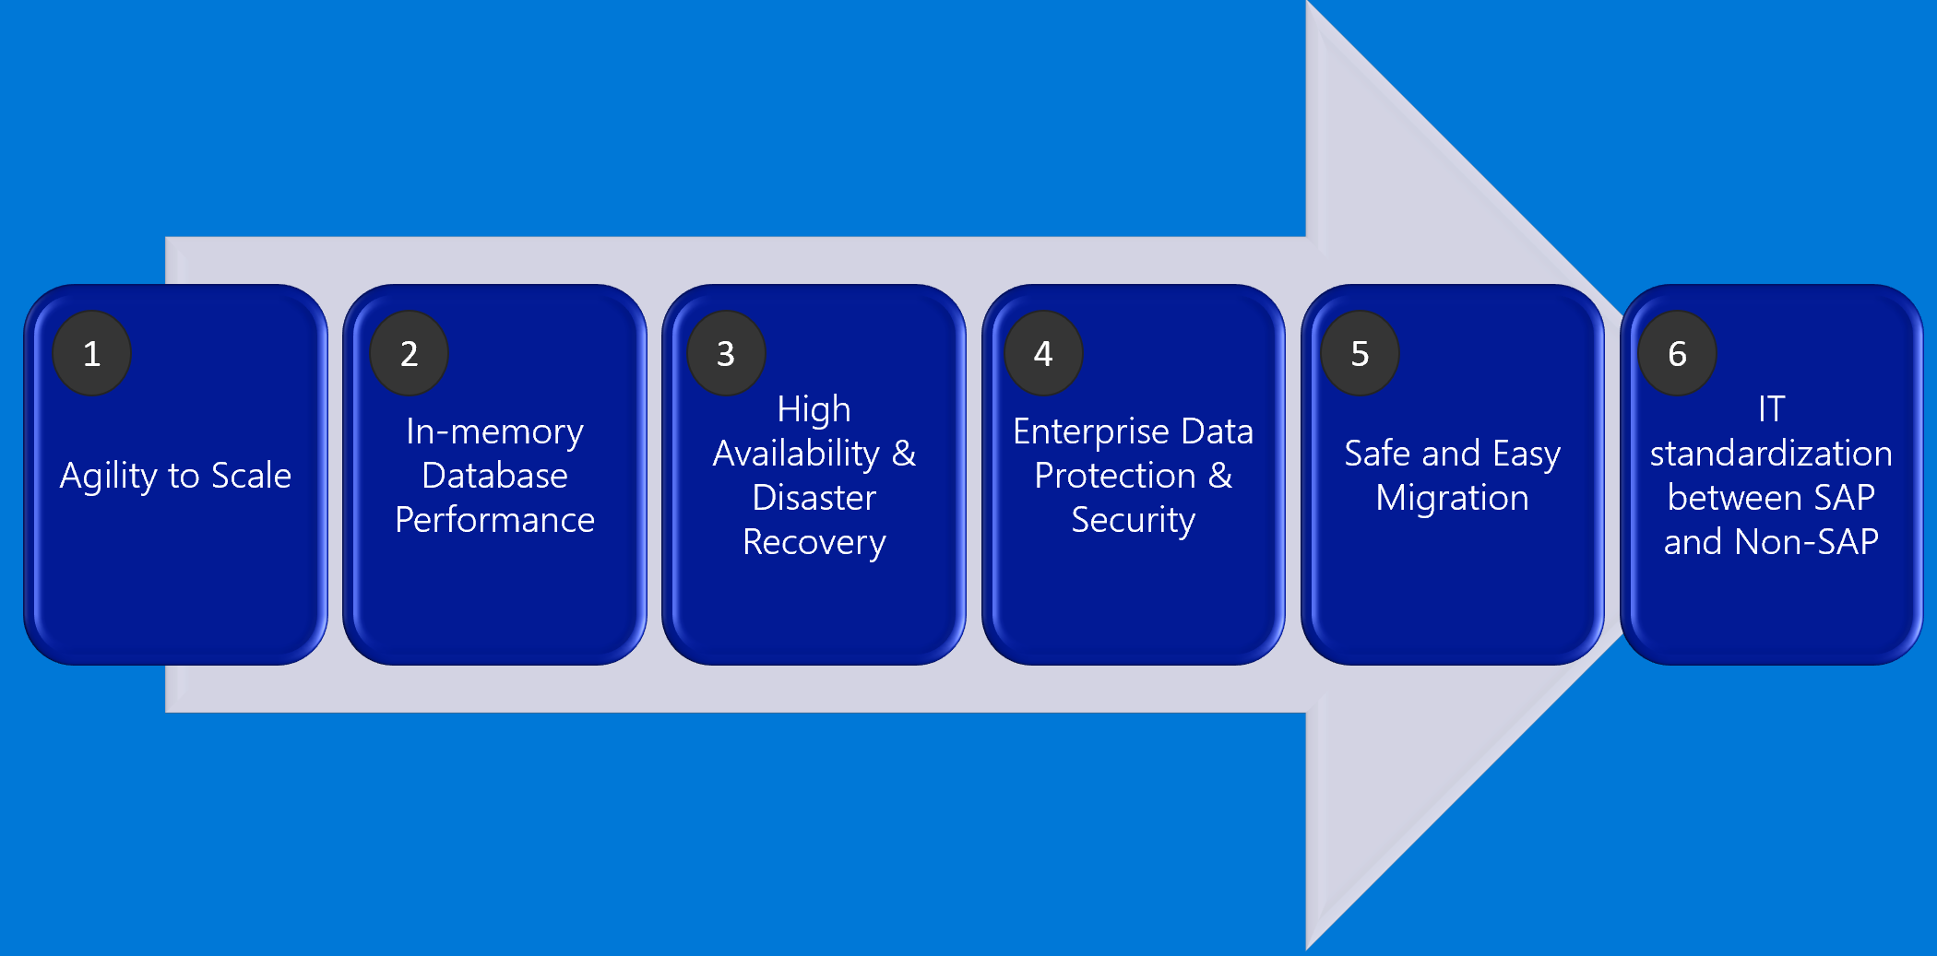
SAP HANA on Cloud

Slide 35
Preferred solution
Azure VMs - HA with no DR
Azure VMs - HA and DR

Slide 36
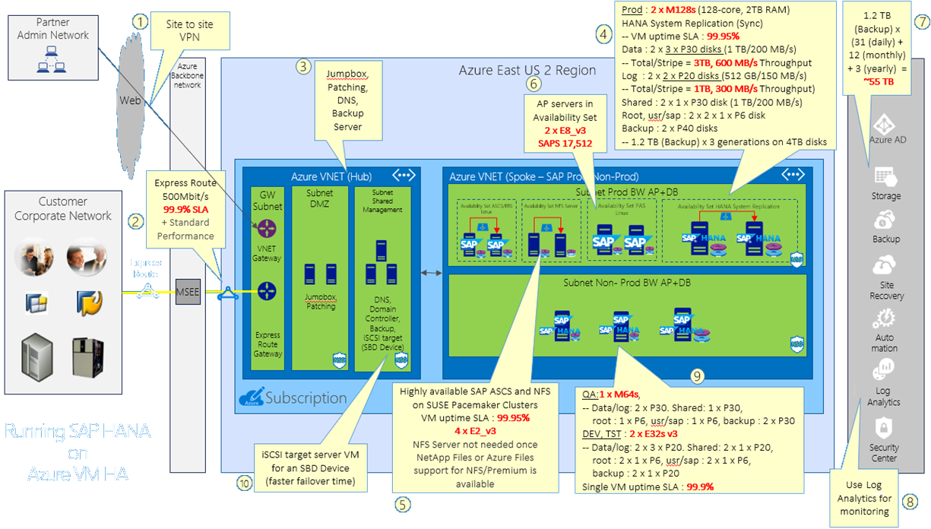
Notes:
This option provides high availability for the SAP HANA components. This is accomplished by provisioning two identically configured M128s Azure VM and a single E2s v3 Azure VM into the same availability set. The two Azure VMs form the database tier and host two identically configured HANA instances replicating synchronously with each other by using HANA System Replication. The single Es2 v3 Azure VM hosts an iSCSI target component and serves the role of an SDB (STONITH Block Device daemon) device in a Pacemaker-based cluster containing the three Azure VMs.
The iSCSI target server can be shared with other Pacemaker clusters. The advantage of using an SBD device is a faster failover time (comparing with the Azure Fence agent that relies on an Azure Active Directory service principal) and, is identical to the way SBD devices are used in on-premises scenarios. It is possible to use up to three SBD devices for a Pacemaker cluster to allow an SBD device to become unavailable, for example during OS patching of the iSCSI target server.
Implementing high availability in the application tier involves provisioning two pairs of Azure VMs, with each pair in its own availability set. The first pair consists of two E2_v3 Azure VMs hosting SAP ASCS and NFS components. The second pair consists of a two E8_v3 Azure VMs, forming a Linux-based cluster, hosting the application servers and delivering total of 17,512 SAPS.
We also provision a non-production SAP HANA environment consisting of a single M64s Azure VM for QA purposes and two E32s v3 Azure VMs that will serve as development and test servers. A couple of E2 v3 Azure VMs deployed into the designated DMZ subnet can be used for remote administration tasks, such as patching.

Slide 37
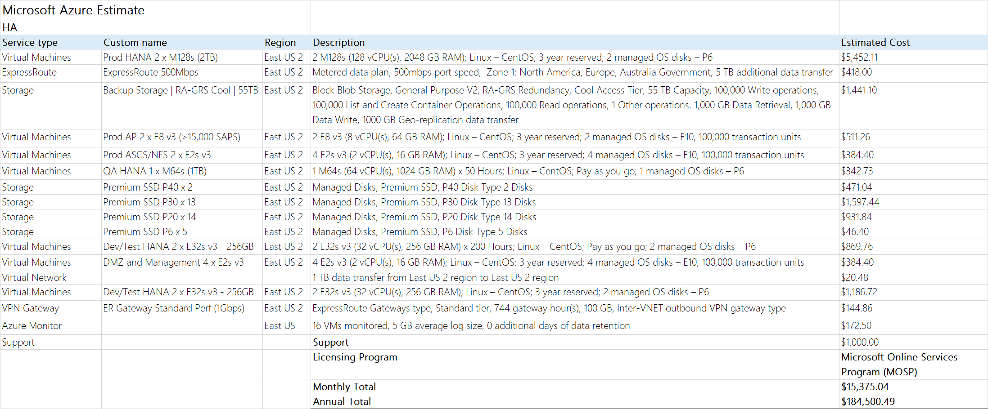
https://azure.com/e/b2bd2105a28a4e86ac8fd74e4cd1076f
Notes:
The cost of the first option reflects charges associated with the components necessary to provide high availability. These components approximately double the cost of a single production instance of the HANA database (for both compute and storage resources). In addition, there are charges associated with implementing high availability of the application tier. In this case, the increase represents compute and storage resources of four E2 v3 Azure VMs that host highly available ASCS and NFS components.
Note that the charges do not take into account licensing, but do include ExpressRoute-related charges, Azure Backup and Azure Monitor costs, and pricing of the Microsoft Professional Direct-level Support.

Slide 38
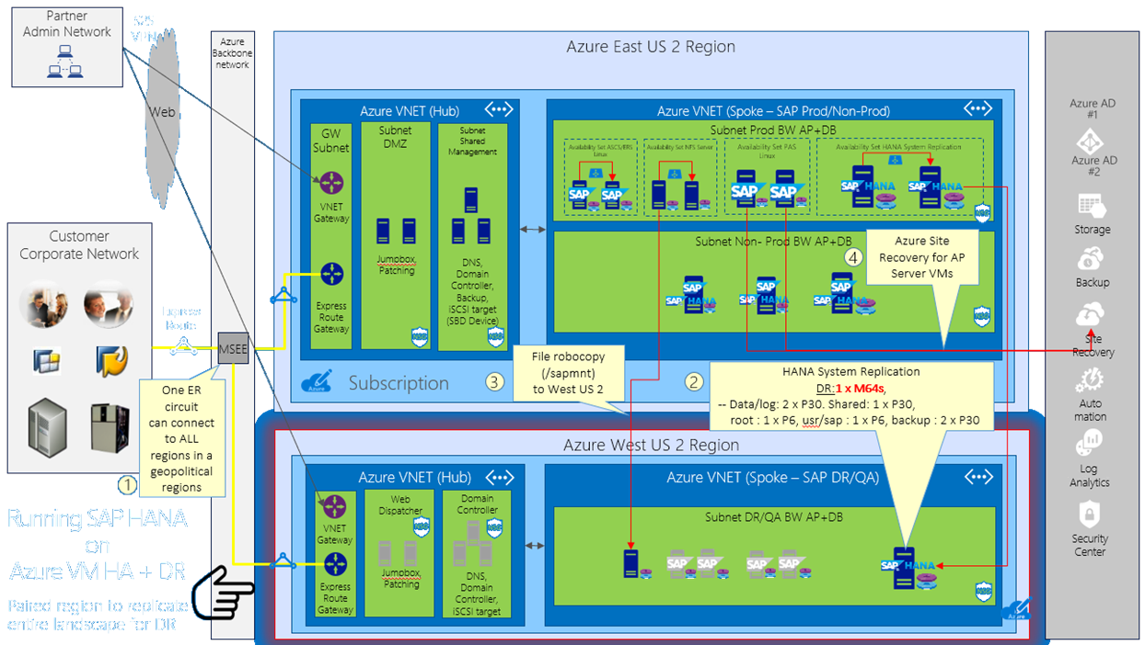
Notes:
To further enhance our design by providing disaster recovery capabilities, we create a virtual network in the West US 2 Azure region and leverage MPLS-based ExpressRoute to provide cross-region and cross-premises connectivity. Next, we deploy another M128s Azure VM in the newly provisioned virtual network and configure it with asynchronous HANA system replication from the cluster hosting the primary database instance. We also leverage Azure Site Recovery to implement a standby disaster recovery environment for the application tier. In order to ensure that the content of the **sapmnt** share is up-to-date, we provision a single E2 v3 Azure VM serving the role of the SAP ASCS DR instance and configure it as target of a scheduled task that performs file robocopy from the production SAP ASCS instance.

Slide 39
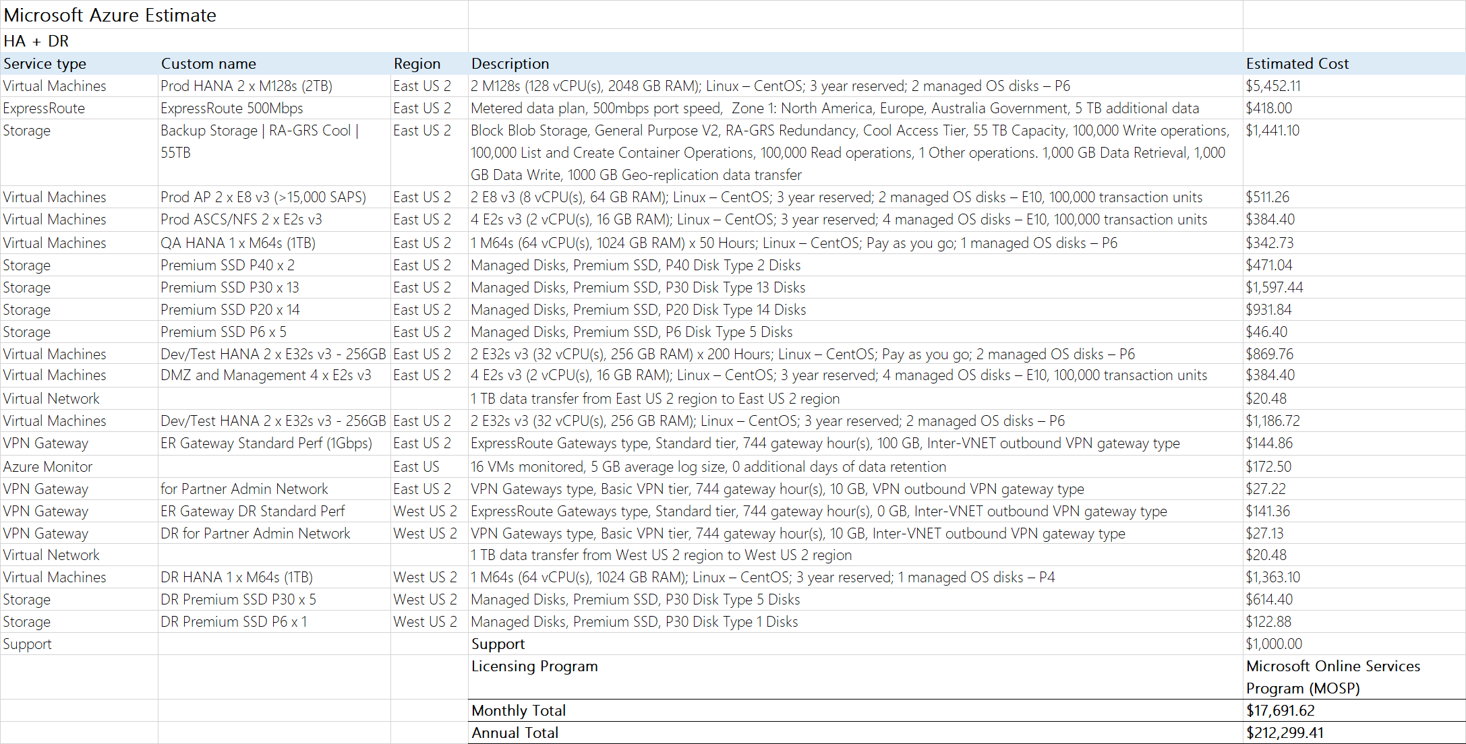
https://azure.com/e/ca7ac8872793450d84b75e594f6bd6ba
Notes:
The extra cost of the second option reflects charges associated with additional components necessary to provide disaster recovery. These components effectively represent the cost of the production instance of a single HANA database instance (for both compute and storage resources). In addition, there are extra charges associated with implementing high availability of the application tier. In this case, the increase represents storage resources of two E2_v3 Azure VMs that host the ASCS and NFS components as well as Azure VMs hosting the SAP production application tier. There is also an added cost of Azure Site Recovery.
Note that the charges do not take into account licensing, but do include ExpressRoute-related charges, Azure Backup and Azure Monitor costs, and pricing of the Microsoft Professional Direct-level Support.

Slide 40
SAP HANA HA on Azure VMs manual setup
Provision Azure infrastructure Azure Linux VMs (Azure)
Update Linux OS (Linux)
Install HA Extensions (Linux)
Set up disk layout (Linux)
Configure name resolution (Azure or Linux)
Install cluster (Linux)
Configure Corosync (Linux)
Install HANA HA packages (Linux)
Install SAP HANA (SAP)
Upgrade SAP Host Agent (SAP)
Configure HANA replication (SAP)
Configure Cluster Framework (Linux)
Configure SDB fencing by using an SDB device or a fencing agent (Linux or Windows)
Register SAP HANA resources (Linux)

Slide 41
SAP HANA HA on Azure VMs manual setup (detailed)
Provision Azure infrastructure and Azure VMs (SLES-for-SAP Applications 12 SP3) by using the Azure Resource Manager model.
Register SLES to ensure access to package repositories (BYOS only), add the public-cloud module, update OS (sudo zipper update).
Install HA Extensions (sudo zypper install sle-ha-release fence-agents).
Set up disk layout.
Configure name resolution (DNS or /etc/hosts).
Notes:
Provision Azure infrastructure and Azure VMs (SLES-for-SAP Applications 12 SP3) by using the Azure Resource Manager deployment model
The same virtual network, subnet, and availability set, separate Premium Storage accounts
Attach Azure Premium storage disks to each VM
Create an internal load balancer
Back-end pool consisting of both Azure VMs, health probe set to TCP 62503, Load balancing rules: TCP 30315 and 30317, Direct Server Return enabled for both
To automate, use the GitHub database template https://portal.azure.com/#create/Microsoft.Template/uri/https%3A%2F%2Fraw.githubusercontent.com%2FAzure%2Fazure-quickstart-templates%2Fmaster%2Fsap-3-tier-marketplace-image-multi-sid-db%2Fazuredeploy.json
Register SLES to ensure access to package repositories (BYOS only), add the public-cloud module, update OS (sudo zipper update)
Install HA Extensions (sudo zypper install sle-ha-release fence-agents)
Set up disk layout
Create physical volumes for all disks that you want to use
Create a volume group for the data files, the log files and the shared HANA directory Create the logical volumes
Create the mount directories and copy the UUID of all logical volumes
Create fstab entries for the three logical volumes
Mount the new volumes
Configure name resolution

Slide 42
SAP HANA HA on Azure VMs manual setup (detailed - cont.)
Install cluster on the first node (sudo ha-cluster-init) and join the second node to the cluster (sudo ha-cluster-join).
Configure corosync transport and nodelist settings (edit /etc/corosync/corosync.conf) and restart corosync service.
Install HANA HA packages (sudo zypper install SAPHanaSR).
Run hdblcm to install SAP HANA.
Upgrade SAP Host Agent.
Configure HANA replication (create keystore, create the primary site, create the secondary site).
Configure Cluster Framework.
Configure SDB fencing by using an SDB device or a fencing agent:
An SDB device (an extra Azure VM hosting iSCSI target server): faster failover times
A fencing agent (an Azure AD service principal): slower, but does not require an extra Azure VM
Register SAP HANA resources.

Slide 43
SAP HANA HA on Azure VMs automated setup
Prepare the deployment environment:
Install deployment software (not required when using Cloud Shell):
Azure CLI
Terraform
Ansible
Clone a deployment repository (*)
Create an Azure AD service principal that will be used by Terraform deployment
Set environment variables storing configuration of the service principal
Upload SAP packages to Azure Storage
Customize the Terraform configuration files
Initialize working directory containing Terraform configuration files by running terraform init
Trigger the deployment by running terraform apply
(*) https://github.com/Azure/sap-hana

Slide 44
Preferred objections handling
ECC remains on-premises until Dec CY20. How can we maintain integrations between ECC and BW?
Microsoft supports a hybrid solution, with symmetry between on-premises applications and those on the public cloud .
Windows Azure Virtual Network allows to create a logically isolated section in Azure and securely connect it to on premises datacenters.
ExpressRoute provides secure, high-bandwidth, low-latency connectivity between Azure and on-premises datacenters.

Slide 45
Preferred objections handling
How much does Azure cost? Give us two options (HA only and HA with DR)
The proposed design offers two options:
HA with no DR
HA and DR
For mission-critical SAP applications using SAP HANA, high availability can be achieved through a highly resilient architecture with active and standby systems that have databases configured with synchronous data replication. If a deployment is non-mission critical, it is possible to ensure high availability for just the data and spin up necessary compute on-demand in the event of a failure.
Disaster recovery can leverage:
Azure Site Recovery Services (A2A scenario)
Replicates SAP application instance VMs and ASCS/SCS VMs to second SAP Azure region
VMs in DR region regions are not up and running (no compute costs)
SAP HANA System Replication in asynchronous replication mode
File robocopy from the production SAP ASCS instance to a single, low-end Azure VM serving the role of the SAP ASCS DR instance

Slide 46
Preferred objections handling
Do I have to pay for virtual machines when they
are stopped?
Azure VM must be in the stopped (deallocated) state in order to avoid compute charges. If the VM is stopped (but not deallocated), it will continue to incur compute charges .
Deallocating does not mean deleting the VM as it still exists in storage .
You will still incur storage charge even if the VM is deallocated.

Slide 47
Preferred objections handling
Can I automate the shutdown of virtual machines at periodic times of day?
Yes, this functionality is available directly from the Azure portal. Alternatively, you can use the Start/Stop VMs during off-hours Azure Automation solution, custom Azure Automation runbooks, or custom Azure PowerShell and Azure CLI scripts to stop and deallocate any instance.
The same approach can be used to start the instance on a scheduled time.
Note that the built-in platform auto-shutdown functionality does not provide the draining functionality of application servers, so it is important to verify that these servers do not have any active tasks before initiating shutdown. This can be implemented by using Azure Automation or Azure functions.

Slide 48
Customer quote
“Azure has provided high availability and disaster recovery capabilities for our production environment at a very reasonable price.”
Andrew Cross, CIO, A. Datum Group

Slide 50
Appendix slides

Slide 51
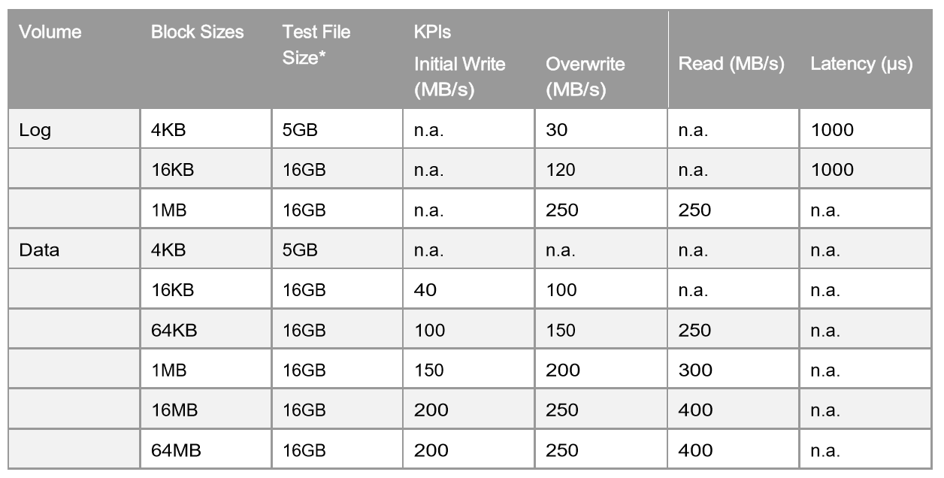
SAP HANA Hardware Configuration Check Tool (HWCCT) – KPIs for Storage (Production)
Source SAP Note: 1943937 - Hardware Configuration Check Tool - Central Note
Notes:
The HWCCT is a tool to verify that is the HANA system configuration – OS, network and storage meets the minimum performance criteria required to run SAP HANA in production.

Slide 52
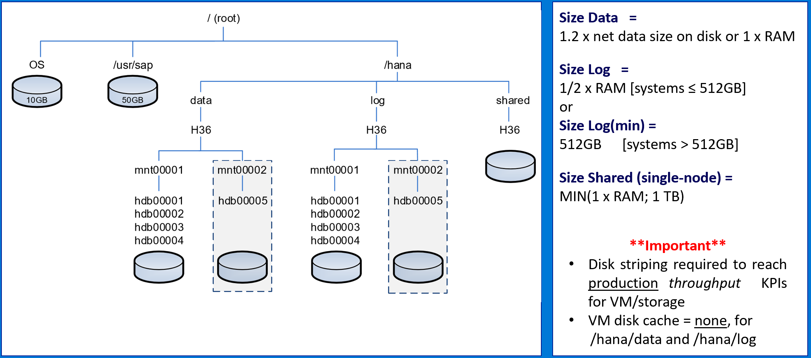
SAP HANA Storage Layout (TDI Best Practice)
Source SAP - SAP HANA Storage Requirements
Notes:
Best practice for sizing persistence (storage) for SAP HANA.

Slide 53
Downtime Minimized Migration (DMO/SUM) to Azure/HANA
DMO with System Move
– change PAS host during DMO
Source SAP: DMO/SUM 1.0 SP21 Guide (source PAS must be UNIX/LINUX based)
Notes:
Downtime minimized migration to HANA via DMO/SUM – system move. Source primary application server (PAS) must be UNIX/LINUX based.

